Slide 1

Department of Computer Science and Engineering
WasteNet: A Structured-Pruned and EMA-Augmented RepVGG Framework for Real-Time Trash Classification
PRESENTED BY
Kakumanu Sravani
Kondavarju Ramya
Chinthalanka Poojitha
(22471A0597)
(22471A05A4)
(22471A0584)
Under the Guidance of,
Dr.Sireesha Moturi,Mtech,Phd
Associate Professor,
Department of Computer Science and Engineering,
Narasaraopeta Engineering College (Autonomous), Narasaraopet- 522 601.
Review No.
Department of CSE

Slide 2
OUTLINE
Abstract
Introduction
Literature Survey
Research Gaps
Problem Statement
Objectives
Block Diagram / Flow Diagram
Methodology
Implementation
Results and Analysis
Conclusion & Future Scope
References
Question and Answers
Acknowledgements
Review No.
Department of CSE

Slide 3
ABSTRACT
RepVGG-MEM is a lightweight and highly accurate Deep Learning model for real-time waste classification
Built on RepVGG architecture with EMA, Mixup augmentation, and structured pruning
Achieves 95.06% accuracy and 94.5% F1 score on 14-class waste classification
Ideal for edge devices and smart mobile waste management systems
Lightweight design enables deployment on smart bins and mobile platforms
Promising solution for automated waste management in real-world situations
Review No.
Department of CSE

Slide 4
INTRODUCTION
Improper segregation causes pollution, greenhouse gas emissions, and resource depletion
Proper segregation separates plastics, organic compounds, glasses, metals, and papers for conservation
Rapid urban growth increases waste with limited public services and health infrastructure
Manual sorting systems are hazardous, time-consuming, and cannot scale with global waste increase
RepVGG-MEM addresses current challenges with lightweight design for real-time waste classification
Review No.
Department of CSE

Slide 5
Model applies EMA for stable learning, Mixup for generalization, and structured pruning for efficiency.
Suitable for smart bins, edge devices, and portable real-time waste sorting in diverse environments.
When recyclable and non-recyclable materials are not properly separated, they end up in landfills, releasing methane and carbon dioxide, which contribute to global warming.
Review No.
Department of CSE

Slide 6
Proper segregation helps in separating plastics, glass, metals, organic waste, and paper at the source, ensuring better recycling and material recovery.
This process supports a cleaner and more sustainable environment by reducing landfill dependency and conserving energy.
Review No.
Department of CSE

Slide 7
CORE CONTRIBUTIONS
Proposed RepVGG-MEM, a lightweight deep learning framework for real-time garbage classification, optimized for accuracy and speed.
Integrated Exponential Moving Average (EMA) during training to stabilize weight updates and improve generalization, especially after pruning.
Applied Mixup data augmentation to enhance robustness against visually similar waste categories and reduce overfitting.
Review No.
Department of CSE

Slide 8
Implemented structured magnitude-based pruning, significantly reducing model complexity while maintaining high classification performance.
Achieved superior results with 95.06% accuracy and 94.5% F1-score, outperforming baseline RepVGG variants.
Designed for edge deployment, enabling practical use in smart bins and mobile waste management systems.
Review No.
Department of CSE

Slide 9
LITERATURE SURVEY
No | Title | Author | Journal & Year | Methodology | Key Findings | Gaps
1 | RepVGG-MEM: Lightweight model for garbage classification | Sayed et al. [4] | IEEE Access, 2025 | RepVGG + MSCA | 93.26% accuracy | Limited generalization
2 | Reliable deep learning model for recyclable waste | Hossen et al. [5] | IEEE Access, 2024 | DenseNet201 + MobileNetV2 | 95.01% accuracy | Moderate complexity
3 | Integrated learning for municipal waste | Tran et al. [6] | IEEE Access, 2024 | Ensemble + HHO | 97.45% accuracy | High computational cost
4 | Detection of recyclable solid waste | Lapo et al. [7] | IEEE Latin America, 2024 | RetinaNet + ResNet-50 | 97% accuracy | Not edge-friendly
5 | Real-time waste detection using YOLOv12 | Dipo et al. [8] | Digital, 2025 | YOLOv12 | 78% mAP | Lower accuracy
Review No.
Department of CSE

Slide 10
LITERATURE SURVEY
Recent Advances in Waste Classification:
Lightweight Models with Attention Mechanisms:
Sayed et al. [4] - RepVGG-MEM with MSCA module → 93.26% accuracy (compact structure, limited generalization)
Hybrid Deep Learning Approaches:
Hossen et al. [5] - RWC-Net (DenseNet201 + MobileNetV2) → 95.01% accuracy (5-fold CV, Score CAM visualization)
Tran et al. [6] - Ensemble (DenseNet161 + ResNet152 + MobileNetV3) + HHO optimization → 97.45% accuracy (high complexity, not edge-friendly)
Object Detection Models:
Lapo et al. [7] - RetinaNet with ResNet-50 backbone → 97% accuracy (recyclable waste detection, computationally expensive)
Dipo et al. [8] - YOLOv12 for real-time classification → 78% mAP (mobile-based, lower accuracy)
Metaheuristic Optimization:
Sayed et al. [9] - InceptionV3 + Multi-objective Beluga Whale Optimization (MBWO) → 97.75% accuracy (complex tuning)
Review No.
Department of CSE

Slide 11
LITERATURE SURVEY
Deep learning models like VGG, DenseNet, and YOLO have proven effective for waste classification.
However, many are computationally intensive, limiting deployment on smart bins or mobile systems.
The proposed WasteNet (RepVGG-MEM) model addresses these issues through structured pruning, EMA-based optimization, and lightweight design for real-time applications.
Review No.
Department of CSE

Slide 12
RESEARCH GAPS
High-accuracy models have heavy computational requirements unsuitable for edge devices
Lightweight models sacrifice accuracy for speed
Lack of unified framework balancing accuracy, speed, and deployability
Independent application of optimization techniques (EMA, Mixup, Pruning) shows suboptimal results
Limited solutions for resource-constrained environments like smart bins and mobile platforms
Missing optimal accuracy-speed-size tradeoff for real-world deployment
Review No.
Department of CSE

Slide 13
RESEARCH GAPS
Existing models for waste classification are computationally heavy and unsuitable for real-time applications.
Most deep learning models lack optimization for edge devices like smart bins and mobile systems.
Accuracy drops occur when classifying visually similar waste materials such as plastic and metal.
Limited dataset diversity affects the model’s generalization in real-world environments.
Few studies focus on combining structured pruning and EMA techniques for performance improvement.
There is a need for a lightweight, accurate, and fast model for smart and sustainable waste management.
Review No.
Department of CSE

Slide 14
PROBLEM STATEMENT
Rapid urbanization generates unprecedented municipal solid waste volumes
Improper segregation causes environmental pollution, greenhouse emissions, and resource depletion
Manual sorting is hazardous, time-consuming, and cannot scale with growing waste volumes
Existing CNN-based models face accuracy-efficiency-deployment tradeoff
High-accuracy models are computationally expensive and unsuitable for edge devices
Lightweight models compromise classification performance
Need for intelligent automated system achieving high accuracy with real-time operation on edge devices
Review No.
Department of CSE

Slide 15
OBJECTIVES
Develop lightweight RepVGG-MEM framework integrating EMA, Mixup, MSCA, and structured pruning for real-time waste classification
Achieve high accuracy (>90%) across 14 waste categories including closely resembling items
Optimize computational efficiency through structured pruning to reduce FLOPs for edge deployment
Enable deployment on resource-constrained devices including smart bins and mobile platforms
Review No.
Department of CSE

Slide 16
DATASET DESCRIPTION
Combined public datasets: TrashNet, Kaggle Garbage, PublicGarbageNet
Over 15,000 labeled images
14 waste categories including plastic, glass, paper, metal, cloths.
Training: 60%
Validation: 20%
Testing: 20%
Ensures reliable and unbiased evaluation
Review No.
Department of CSE

Slide 17
DATASET CATEGORY DISTRIBUTION
Review No.
Department of CSE

Slide 18
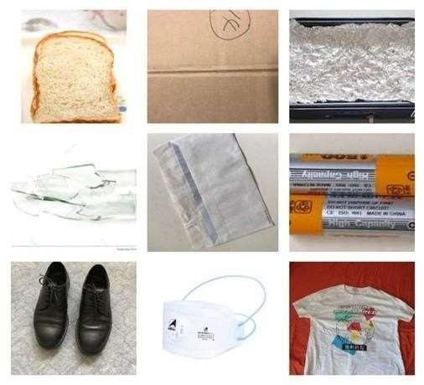
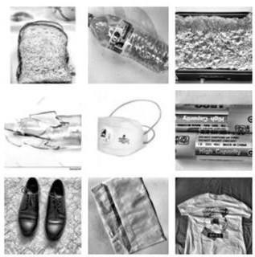
PRE - PROCESSING
Review No.
Department of CSE

Slide 19
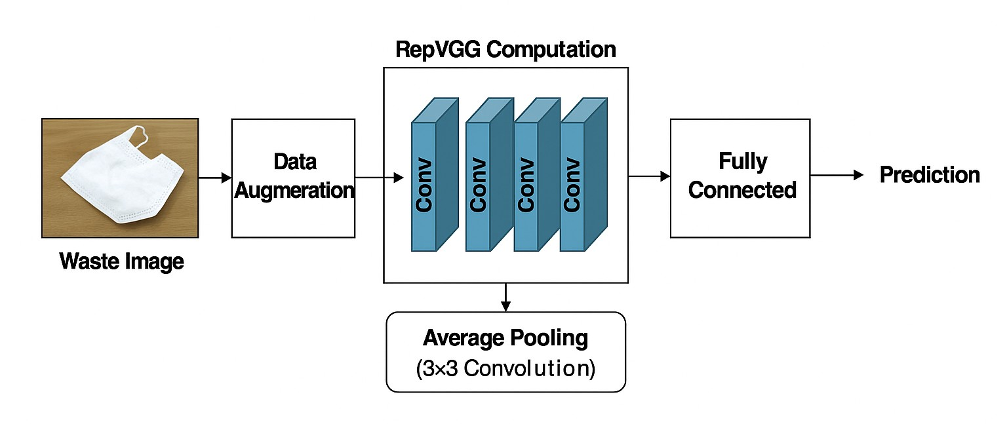
BLOCK DIAGRAM OR FLOW DIAGRAM
Review No.
Department of CSE

Slide 20
The block diagram illustrates the complete workflow of the WasteNet (RepVGG-MEM) model designed for real-time trash classification. The diagram provides a clear visual representation of how raw input data is processed and transformed into accurate waste category predictions.
Input Layer: The process begins with the input of waste images, which are captured from various sources such as cameras, smartphones, or IoT-enabled sensors. These images may vary in size, lighting, and orientation.
Preprocessing Module: Before feeding the images into the neural network, they undergo preprocessing steps including resizing, normalization, and data augmentation to improve model robustness and performance.
Review No.
Department of CSE

Slide 21
Feature Extraction with RepVGG Backbone: The preprocessed images are passed through the RepVGG backbone, which extracts deep, hierarchical features. RepVGG combines the benefits of VGG-like simplicity during inference with multi-branch structures during training, enabling high accuracy with computational efficiency.
Memory Enhancement Module (MEM): The extracted features are further refined through the MEM, which enhances the network's ability to capture contextual and discriminative information, especially for similar-looking waste items.
Classification Layer: The refined features are then passed through fully connected layers, followed by a softmax activation function that predicts the probability distribution across predefined waste categories.
Output Layer: The final stage outputs the predicted waste category, enabling real-time classification of the input image into types such as plastic, paper, metal, organic, or glass.
Feedback and Optimization: The model also incorporates training feedback through loss computation and backpropagation, allowing continuous learning and improvement of classification accuracy.
Review No.
Department of CSE

Slide 22
METHODOLOGY
Dataset Sources:
TrashNet, Kaggle Garbage Classification, PublicGarbageNet
Total: 15,000+ labeled images across 14 waste categories
Waste Categories:
Cardboard, Electronics, Plastic, Paper, Metal, Glass, Food, Clothing, Shoes, Battery.
Dataset Distribution:
Clothing: 20.4%, Glass: 18.4%, Shoes: 12.1%
Plastic, Biological, Battery: <6% (imbalanced)
Dataset Split:
Training: 60%
Validation: 20%
Testing: 20%
Image Resolution: 224×224 pixels
Review No.
Department of CSE

Slide 23
Waste Categories: Includes Cardboard, Electronics, Plastic, Paper, Metal, Glass, Food, Clothing, Shoes, Battery, etc.
Data Imbalance: Clothing (20.4%), Glass (18.4%), Shoes (12.1%), Plastic, Biological, Battery <6%; handled using augmentation and preprocessing.
Preprocessing: Images resized to 224×224 pixels, normalized, and augmented (rotation, flip, scaling) for better model training.
Dataset Split: Training (60%), Validation (20%), Testing (20%) for proper evaluation.
Feature Extraction: Used RepVGG backbone to extract deep features from images.
Review No.
Department of CSE

Slide 24
Memory Enhancement Module (MEM): Refines features to improve classification of similar waste types
Classification: Fully connected layers and softmax function predict waste category.
Evaluation: Accuracy, precision, recall, and F1-score used to measure performance.
Dataset Preparation Collected 15,000+ labeled images from TrashNet, Kaggle Garbage Classification, and PublicGarbageNet across 14 waste categories; images resized to 224×224 pixels and augmented to handle class imbalance.
Feature Extraction & Model Used RepVGG backbone with Memory Enhancement Module (MEM) to extract and refine features for accurate waste classification.
Review No.
Department of CSE

Slide 25
Memory Enhancement Module (MEM): Refines features to improve classification of similar waste types
Classification: Fully connected layers and softmax function predict waste category.
Evaluation: Accuracy, precision, recall, and F1-score used to measure performance.
Dataset Preparation Collected 15,000+ labeled images from TrashNet, Kaggle Garbage Classification, and PublicGarbageNet across 14 waste categories; images resized to 224×224 pixels and augmented to handle class imbalance.
Feature Extraction & Model Used RepVGG backbone with Memory Enhancement Module (MEM) to extract and refine features for accurate waste classification.
Review No.
Department of CSE

Slide 26
IMPLEMENTATION
RepVGG-MEM Architecture
Core Components:
RepVGG Backbone • Multi-branch training (3×3 + 1×1 conv + identity)
• Structural reparameterization to single 3×3 conv at inference
MSCA • Multi-Scale Channel Attention after Stage 3
• Global Average Pooling → Bottleneck (1/16) → Sigmoid activation
EMA Training • Exponential Moving Average with decay=0.999
• Stabilizes parameters during and after pruning
Structured Pruning • L1-norm magnitude-based filter elimination
• Removes bottom a% filters → Fine-tune 15 epochs • Reduces to 0.55G FLOPs
Review No.
Department of CSE

Slide 27
ACCURACY COMPARISON OF MODELS
Review No.
Department of CSE

Slide 28
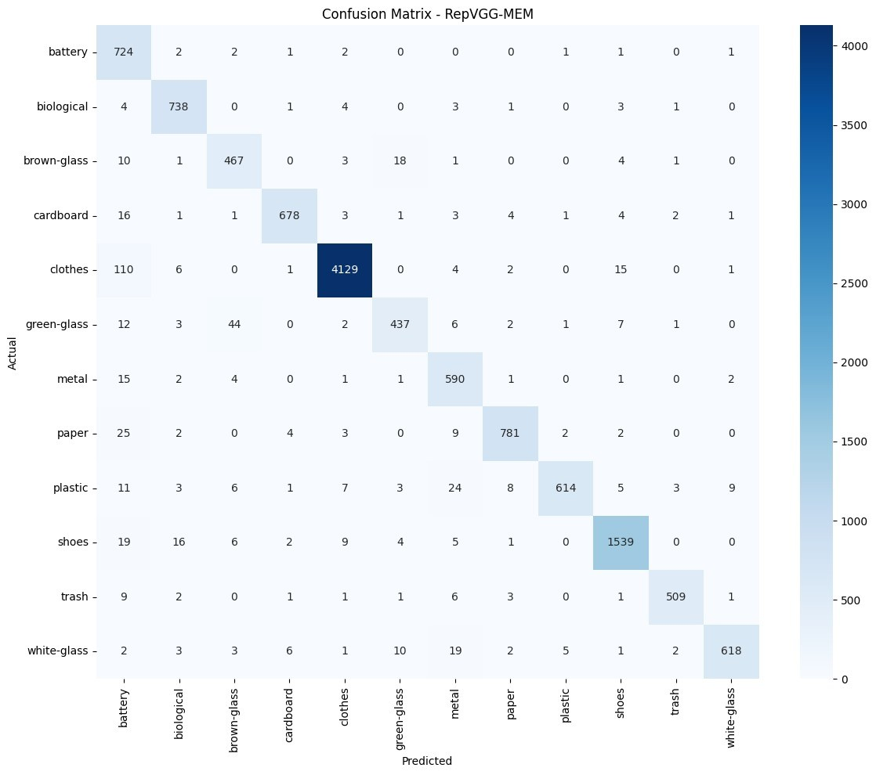
RESULTS & ANALYSIS
Review No.
Department of CSE

Slide 29
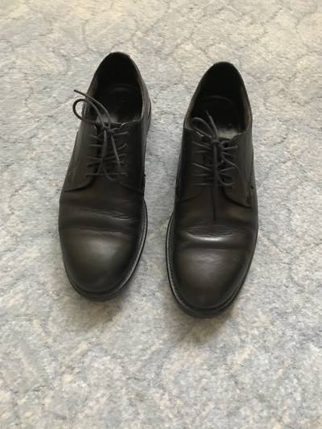
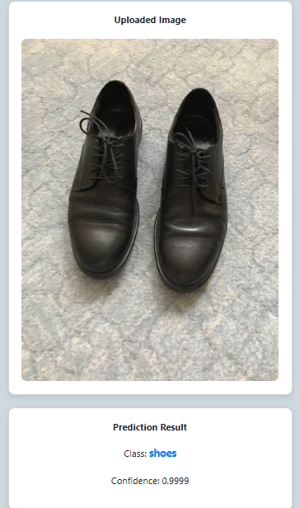
OUTPUT
Review No.
Department of CSE

Slide 30
Key Observations: High Performance: Clothing (4,129 correct), Paper, Shoes, White Glass Strong feature learning for recyclable and non-recyclable materials Minor misclassifications between visually similar categories Dataset imbalance evident: Clothing (20.4%), Glass (18.4%) vs Plastic/Battery (<6%) Model Capability: Successfully learns distinctive features across 14 diverse waste categories Robust classification for both recyclable and non-recyclable materials
Review No.
Department of CSE

Slide 31
CONCLUSION
Developed RepVGG-MEM: lightweight framework for real-time waste classification
Achieved 95.06% accuracy and 94.5% F1-score with 0.55G FLOPs
Unified integration of EMA, Mixup, MSCA, and structured pruning
+1.74% improvement over baseline with reduced computational cost
Edge-ready deployment on smart bins and mobile platforms
it combines structured pruning and Exponential Moving Average (EMA) to enhance speed, stability, and accuracy.
The lightweight architecture enables deployment on edge devices, smart bins, and mobile applications.
Review No.
Department of CSE

Slide 32
LIMITATIONS
Dataset imbalance affects performance on under-represented waste categories.
Reliance on open-source datasets may not fully capture real-world conditions such as poor lighting, occlusion, or mixed waste.
Fixed class structure requires retraining when new waste categories are introduced.
Training still computationally intensive, despite the model being lightweight during inference.
Complex scenarios like overlapping, damaged, or dirty waste objects are not explicitly addressed.
Review No.
Department of CSE

Slide 33
FUTURE SCOPE
Expand dataset to cover more waste categories and real-world conditions
Handle overlapping, damaged items, and dust
Optimize for ultra-low-powered IoT devices
Integrate real-time monitoring with sensor fusion
Hybrid approaches: computer vision + spectroscopy
Adaptive learning for new categories without full retraining
The model can be integrated with IoT-based smart bins for automatic waste detection and separation.
Can be extended to real-time video classification for monitoring waste in streets or public areas.
Review No.
Department of CSE

Slide 34
REFERENCES
[1] K. Lakshminadh et al., "Pest identification: An efficient deep learning approach using vgg networks," in IEEE International Conference on Interdisciplinary Approaches in Technology and Management for Social Innovation (IATMSI), 2025, pp. 1–6.
[2] K. V. N. Reddy, Y. Narendra, M. A. N. Reddy, A. Ramu, D. V. Reddy, and S. Moturi, "Traffic sign recognition using cnn deep learning," in IEEE International Conference on Interdisciplinary Approaches in Technology and Management for Social Innovation (IATMSI), 2025, pp. 1–6.
[3] S. L. Jagannadham, K. L. Nadh, and M. Sireesha, "Brain tumour detection using cnn," in 5th International Conference on I-SMAC (IoT in Social, Mobile, Analytics and Cloud), 2021, pp. 734–739.
[4] Q. Si and S. Ik Han, "Repvgg-mem: A lightweight model for garbage classification achieving a balance between accuracy and speed," IEEE Access, vol. 13, pp. 36 451–36 469, 2025.
[5] M. M. Hossen, M. E. Majid, S. B. A. Kashem, A. Khandakar, M. Nashbat, A. Ashraf, M. Hasan-Zia, A. K. A. Kunju, S. Kabir, and M. E. H. Chowdhury, "A reliable and robust deep learning model for effective recyclable waste classification," IEEE Access, vol. 12, pp. 13 809–13 821, 2024.
.
Review No.
Department of CSE

Slide 35
[6] H. M. Tran, T. M. Le, H. V. Pham et al., "An integrated learning approach for municipal waste classification using densenet161 and hho," IEEE Access, 2024. [Online]. Available: https://doi.org/10.1109/ACCESS.2024.3495982
[7] J. R. Lapo and O. M. Cumbicus-Pineda, "Detection of recyclable solid waste using convolutional neural networks and pytorch," IEEE Latin America Transactions, vol. 22, no. 6, pp. 475–483, 2024[8] M. H. Dipo, F. A. Farid, M. S. A. Mahmud, M. Momtaz, S. Rahman, J. Uddin, and H. A. Karim, "Real-time waste detection and classification using yolov12-based deep learning model," Digital, vol. 5, no. 2, p. 19, 2025.
[9] G. I. Sayed, M. Abd Elfattah, A.-B. Darwish et al., "Intelligent and sustainable waste classification model based on multi-objective beluga whale optimization and deep learning," Environmental Science and Pollution Research, vol. 31, pp. 31 492–31 510, 2024. [Online]. Available: https://doi.org/10.1007/s11356-024-33233-w
[10] M. Chhabra, B. Sharan, M. Elbarachi, and M. Kumar, "Intelligent waste classification approach based on improved multi-layered convolutional neural network," Multimedia Tools and Applications, vol. 31, pp. 84 095–84 120, 2024. [Online]. Available: https://doi.org/10.1007/s11042-024-18939-w
Review No.
Department of CSE

Slide 36
[11] S. Rafi, A. L. Niharika, S. Neelima, K. Nikhitha, M. S. Reddy, and M. Sireesha, "Detecting sarcasm across headlines and text," in 2025 IEEE International Conference on Interdisciplinary Approaches in Technology and Management for Social Innovation (IATMSI), vol. 3, 2025, pp. 1–6.
[12] S. Moturi, M. Ainavolu, N. R. Dokku, P. Kasula, N. Yaragani, and V. Dodda, "Enhanced lung cancer detection using deep learning ensemble approach," in 2024 First International Conference for Women in Computing (InCoWoCo), 2024, pp. 1–7.
[13] D. Venkatareddy, K. N. Reddy, Y. Sowmya, Y. Madhavi, S. C. Asmi, and S. Moturi, "Explainable fetal ultrasound classification with cnn and mlp models," in 2024 First International Conference on Innovations in Communications, Electrical and Computer Engineering (ICICEC), 2024, pp. 1–7.
[14] S. L. Jagannadham, K. L. Nadh, and M. Sireesha, "Brain tumour detection using cnn," in 2021 Fifth International Conference on I-SMAC (IoT in Social, Mobile, Analytics and Cloud) (I-SMAC), 2021, pp. 734–739.
Review No.
Department of CSE

Slide 37
QUESTIONS and ANSWERS
• Q1: What is the main reason for choosing the RepVGG-MEM model? A: It is lightweight, fast, and suitable for real-time waste classification on edge devices.
• Q2: Which datasets were used in your project? A: TrashNet, Kaggle Garbage Classification, and PublicGarbageNet (15,000+ images).
• Q3: What preprocessing techniques were applied? A: Resize & Crop, Gaussian Blur, Grayscale, CLAHE, Normalization, RGB restoration, and Augmentations (Flip, Rotation).
• Q4: How does MSCA (Multi-Scale Channel Attention) help? A: It highlights important channels and improves feature extraction across multiple scales.
Review No.
Department of CSE

Slide 38
• Q5: Why is pruning used in your model? A: It reduces model complexity, improves speed, and makes deployment easier on low-powered devices.
• Q6: What limitations does your system currently have?
A: Dataset imbalance, limited real-world conditions, and difficulty with overlapping waste items.
• Q7: What is the future scope of your project? A: Expand dataset, improve real-time deployment, add new waste categories, and integrate sensor-based hybrid classification.
Review No.
Department of CSE

Slide 39
ACKNOWLEGEMENTS
• We express our sincere gratitude to Narasaraopeta Engineering College (Autonomous) for providing the opportunity to present our project.
• We thank our Project Guide, Dr. Sireesha Moturi, for continuous guidance, support, and valuable feedback throughout the work.
• We acknowledge the Department of Computer Science and Engineering for academic support, resources, and encouragement.
• We appreciate the use of publicly available datasets and research contributions that supported the development of this work.
• For any further queries, the team can be contacted through the email IDs mentioned:
jaysri0345@gmail.com
ramyakondavarju@gmail.com
poojithach31@gmail.com
Review No.
Department of CSE

Slide 40
THANK YOU
Review No.
Department of CSE

